Slide 1
Web Frontend Development CSS text
ZhuHua

Slide 2
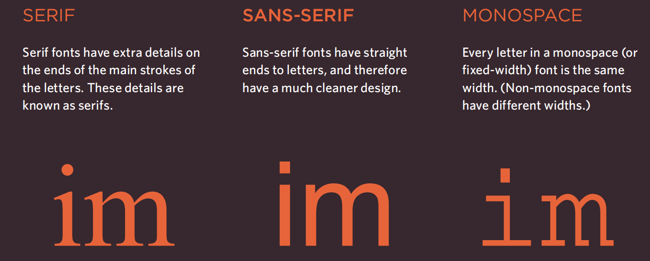
Typeface Terminology

Slide 3
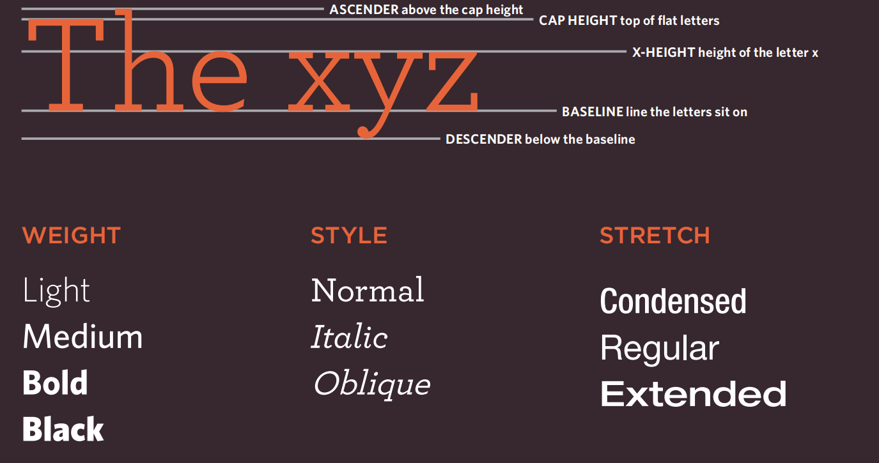
Typeface Terminology

Slide 4
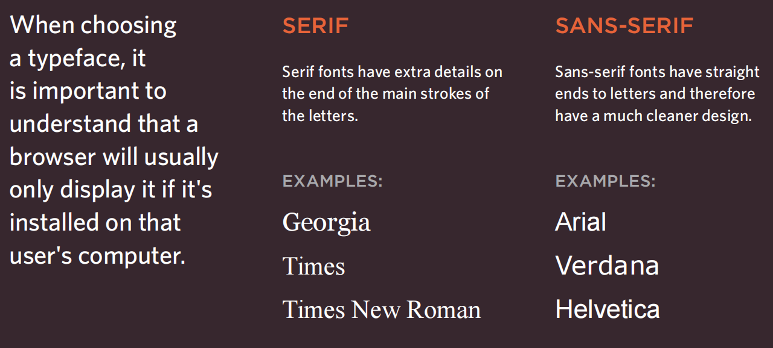
Choosing a Typeface for your Website

Slide 5
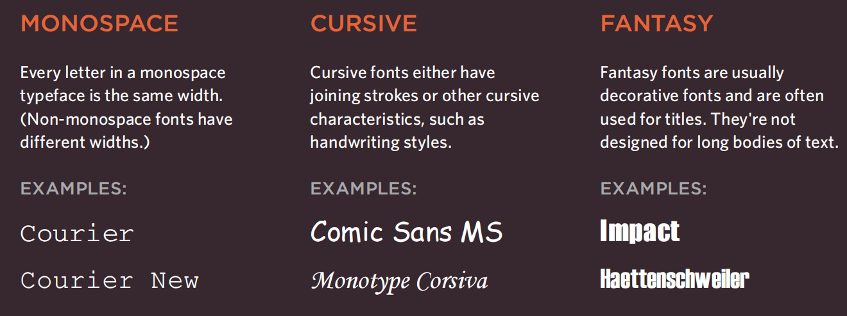
Choosing a Typeface for your Website

Slide 6
Specifying Typefaces
The font-family property allows you to specify the typeface that should be used for any text inside the element(s) to which a CSS rule applies.
The value of this property is the name of the typeface you want to use. The people who are visiting your site need the typeface you have specified installed on their computer in order for it to be displayed.
You can specify a list of fonts separated by commas so that, if the user does not have your first choice of typeface installed, the browser can try to use an alternative font from the list
font-family: Arial, Verdana, sans-serif;

Slide 7
Size of Type
The font-size property enables you to specify a size for the font. There are several ways to specify the size of a font.
The most common are: pixels Pixels are commonly used because they allow web designers very precise control over how much space their text takes up. The number of pixels is followed by the letters px.
percentages The default size of text in browsers is 16px. So a size of 75% would be the equivalent of 12px, and 200% would be 32px
ems An em is equivalent to the width of a letter m
font-size: 200%; font-size: 1.3em; font-size: 12px

Slide 8
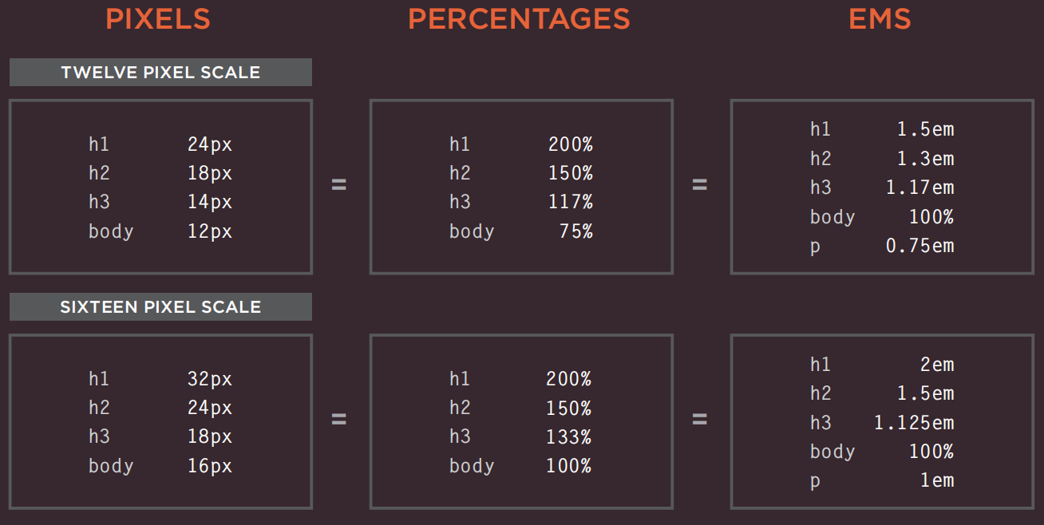
Units of Type Size

Slide 9
More Font Choice
@font-face allows you to use a font, even if it is not installed on the computer of the person browsing, by allowing you to specify a path to a copy of the font, which will be downloaded if it is not on the user's machine.
https://www.fontsquirrel.com/
@font-face {font-family: 'ChunkFiveRegular';
src: url('fonts/chunkfive.eot');}
h1, h2 {font-family: ChunkFiveRegular, Georgia, serif;}

Slide 10
Bold font-weight
The font-weight property allows you to create bold text.
There are two values that this property commonly takes:
normal This causes text to appear at a normal weight.
bold This causes text to appear bold.

Slide 11
font-style
If you want to create italic text, you can use the font-style property.
There are three values this property can take:
normal This causes text to appear in a normal style (as opposed to italic or oblique).
italic This causes text to appear italic.
oblique This causes text to appear oblique.

Slide 12
UpperCase & LowerCase
The text-transform property is used to change the case of text giving it one of the following values:
uppercase This causes the text to appear uppercase.
lowercase This causes the text to appear lowercase.
capitalize This causes the first letter of each word to appear capitalized.

Slide 13
Underline & Strike text-decoration
The text-decoration property allows you to specify the following values:
none This removes any decoration already applied to the text.
underline This adds a line underneath the text.
overline This adds a line over the top of the text.
line-through This adds a line through words.
blink This animates the text to make it flash on and off (however this is generally frowned upon, as it is considered rather annoying).

Slide 14
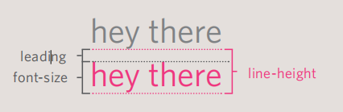
Leading line-height
Leading (pronounced ledding) is a term typographers use for the vertical space between lines of text. In a typeface, the part of a letter that drops beneath the baseline is called a descender, while the highest point of a letter is called the ascender.
Leading is measured from the bottom of the descender on one line to the top of the ascender on the next.

Slide 15
Letter & Word Spacing
Kerning is the term typographers use for the space between each letter. You can control the space between each letter with the letter-spacing property.
It is particularly helpful to increase the kerning when your heading or sentence is all in uppercase. If your text is in sentence (or normal) case, increasing or decreasing the kerning can make it harder to read.
You can also control the gap between words using the word-spacing property. When you specify a value for these properties, it should be given in ems, and it will be added on top of the default value specified by the font.
letter-spacing: 0.2em; word-spacing: 1em;

Slide 16
Alignment text-align
The text-align property allows you to control the alignment of text. The property can take one of four values:
left This indicates that the text should be left-aligned.
right This indicates that the text should be right-aligned.
center This allows you to center text.
justify This indicates that every line in a paragraph, except the last line, should be set to take up the full width of the containing box.

Slide 17
Vertical Alignment vertical-align
The vertical-align property is a common source of confusion. It is not intended to allow you to vertically align text in the middle of block level elements such as <p> and <div>, although it does have this effect when used with table cells (the <td> and <th> elements).
It is more commonly used with inline elements such as <img>, <em>, or <strong> elements. When used with these elements, it performs a task very similar to the HTML align attribute used on the <img> element. The values it can take are:
baseline sub super top text-top middle bottom text-bottom

Slide 18
Indenting Text text-indent
The text-indent property allows you to indent the first line of text within an element.
The amount you want the line indented by can be specified in a number of ways but is usually given in pixels or ems.
It can take a negative value, which means it can be used to push text off the browser window.
text-indent: -9999px;

Slide 19
CSS3: Drop Shadow
The text-shadow property has become commonly used despite lacking support in all browsers. It is used to create a drop shadow, which is a dark version of the word just behind it and slightly offset.
It can also be used to create an embossed effect by adding a shadow that is slightly lighter than the text. The value of this property is quite complicated because it can take three lengths and a color for the drop shadow. text-shadow: 1px 1px 3px #666666;
The first length indicates how far to the left or right the shadow should fall.
The second value indicates the distance to the top or bottom that the shadow should fall.
The third value is optional and specifies the amount of blur that should be applied to the drop shadow.
The fourth value is the color of the drop shadow.

Slide 20
First Letter or Line
You can specify different values for the first letter or first line of text inside an element using :first-letter and :first-line.
Technically these are not properties. They are known as pseudo-elements. You specify the pseudo-element at the end of the selector, and then specify the declarations as you would normally for any other element
p.intro:first-letter {font-size: 200%;}
p.intro:first-line {font-weight: bold;}

Slide 21
Styling Links:link, :visited
In CSS, there are two pseudo_x0002_classes that allow you to set different styles for links that have and have not yet been visited.
:link This allows you to set styles for links that have not yet been visited.
:visited This allows you to set styles for links that have been clicked on.
a:link {color: deeppink;text-decoration: none;}
a:visited {color: black;}
a:hover {color: deeppink;text-decoration: underline;}
a:active {color: darkcyan;}

Slide 22
Responding to Users :hover, :active, :focus
There are three pseudo-classes that allow you to change the appearance of elements when a user is interacting with them.
:hover This is applied when a user hovers over an element with a pointing device such as a mouse. This has commonly been used to change the appearance of links and buttons when a user places their cursor over them.
:active This is applied when an element is being activated by a user; for example, when a button is being pressed or a link being clicked.
:focus This is applied when an element has focus. Any element that you can interact with, such as a link you can click on or any form control can have focus.

Slide 23
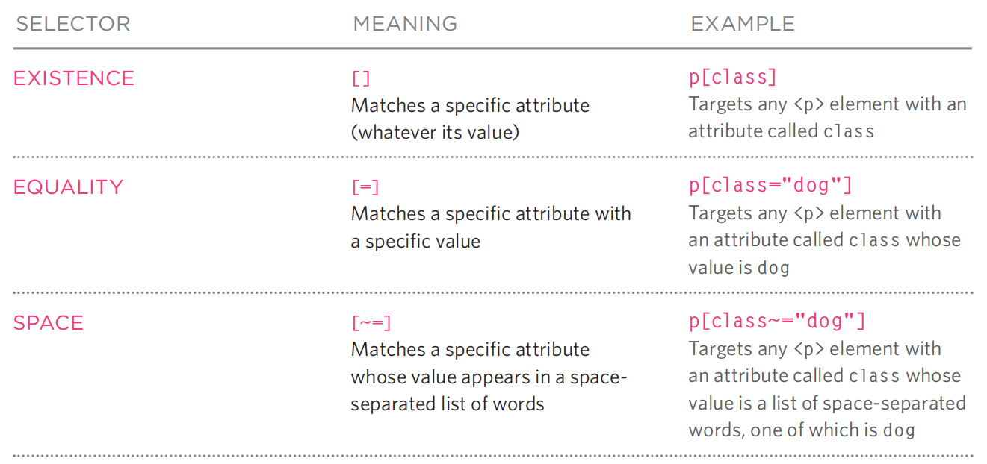
Attribute Selectors
There are also a set of attribute selectors that allow you to create rules that apply to elements that have an attribute with a specific value.

Slide 24
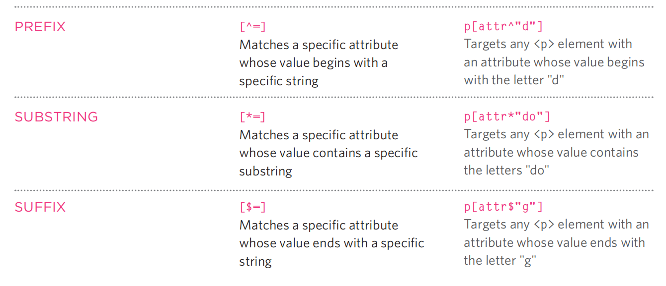
Attribute Selectors

Slide 25
Summary
There are properties to control the choice of font, size, weight, style, and spacing.
There is a limited choice of fonts that you can assume most people will have installed. If you want to use a wider range of typefaces there are several options, but you need to have the right license to use them.
You can control the space between lines of text, individual letters, and words.
Text can also be aligned to the left, right, center, or justified. It can also be indented.
You can use pseudo-classes to change the style of an element when a user hovers over or clicks on text, or when they have visited a link

Slide 26
Questions？
What is the correct CSS pseudo-class to style a link when it has been visited?
a:hover
a:visited
a:active
a:link

Slide 27
Questions？
What is the correct CSS pseudo-class to style a link when it has been visited?
a:hover
a:visited
a:active
a:link

